Slide 1
Vehicle Requisition System
Team – B

Slide 2
Objectives
Build a Automated system of Vehicle Requisition for BCC.

Slide 3
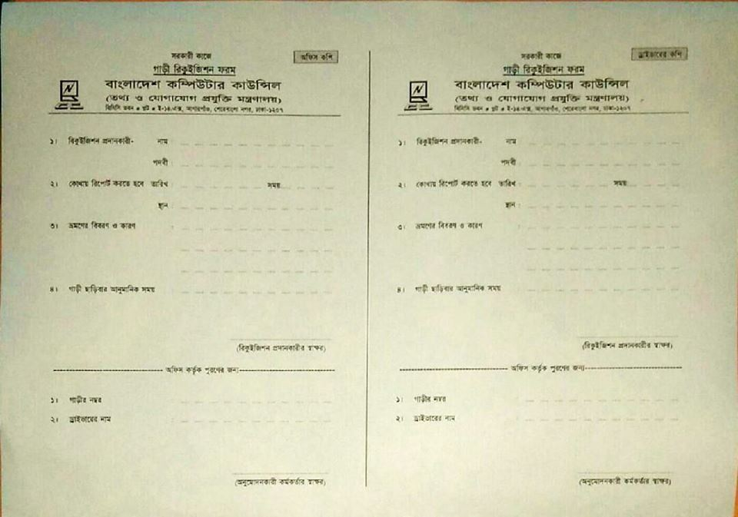
Existing system
To request for a car requisition the user needed to fill-up a requisition form and submit it to the office.

Slide 4
Background
The present vehicle requisition system is manually. This Software will automated the Vehicle Requisition System into a web based application from existing manual process. Employees of the BCC can submit a request of requisition from Web and need not to visit personally. A Controller will grant/reject the request for a vehicle also from the same application on web.

Slide 5
Goal of the Application
The Application must be a totally computerized Web Base system.
Easy to use.
The application requires very basic computer knowledge such as Web login, fill up a web form, click to submit a request.
The application will show previous records of vehicle requisition request and their status.
Response from the vehicle requisition controller will be send as a notification to the requester immediately.
The application will save the paperwork and time so the productivity will be increased.

Slide 6
Software Requirement Specification: “Role”
System Administrator:
System Administrator will have all access to the software. He/she can create new items, edit/delete existing items. Can edit environment of the Application such as add vehicle, add vehicle controller and employee.
Vehicle Requisition Controller:
Vehicle Requisition controller can approve/reject a requisition requests.
Edit the requisition status of a request. He also be able to assign/withdraw a “Driver” to a “Vehicle”.
Employee:
The employee can send a request of requisition.
Cancel his own unresolved request
View his/her requests history with requisition status.
Vehicle:
A requisition will be assigned to a Vehicle
Driver:
As the responsible for a vehicle, a driver will have notifications of any form about assigned trip to his vehicle.

Slide 7
Story Line
Employee:
Employee must have User ID and Password to log in the web application. After log in employee can submit a new requests, cancel his own request which has not responded by the controller yet, view request history with status. Employee can change his password.
Controller:
Vehicle Requisition controller can approve/reject a requisition requests. Edit the requisition status of a request. He also be able to assign/withdraw a “Driver” to a “Vehicle”. search for certain information and print the search result.
System Administrator:
System Administrator will be responsible for creating new items and edit/delete existing items such as add or remove Employee, vehicle Controller, Driver, vehicle etc. He will be responsible for maintenance of the software and Database related jobs.

Slide 8
Application Security
The Application can be accessed from Web only after providing a authenticated User ID and Password.
Employee and Controller can change their own password only.
Any change to the profile/item only could be done by Administrator.

Slide 9
System Development Environment
Application Development:
ASP .NET MVC 5
Entity Framework (Code first)
Laired Architecture.
HTML-5, CSS-3 and Bootstrap
Java Script & JQuery
Application Database:
Microsoft SQL Server

Slide 10
Hardware Requirement
Server
Client

Slide 11
Software Requirement
Server
Client

Slide 12
Use case Diagram
Log In
Vehicle Controller
Add/Edit Vehicle, Controller , Employee & Driver
System Administrator
Requisition
Requisition Search
Employee
Check In
Check Out
Cancel Requisition
Re-Assign
List Vehicle
Driver
Get Notification

Slide 13
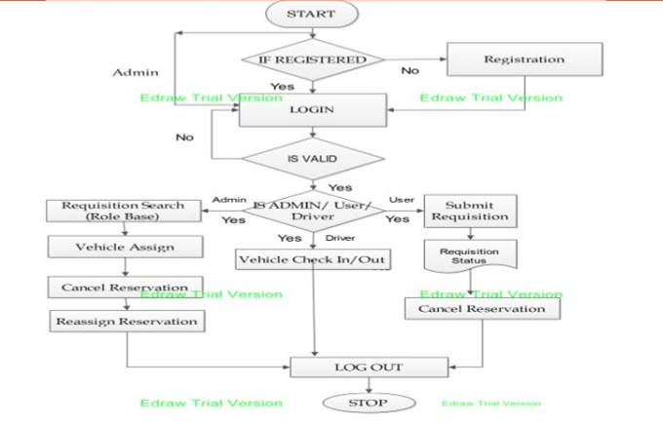
Operation Flow Diagram

Slide 14
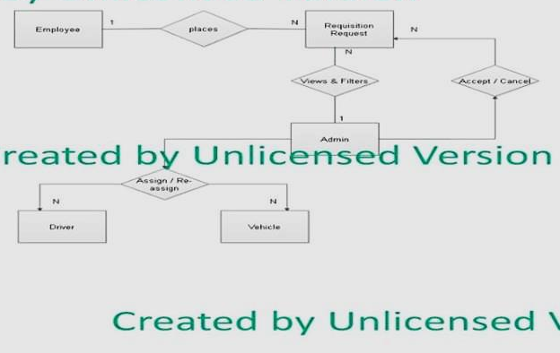
UML Diagram: E-R Diagram

Slide 15
New Vehicle Entry Form
Object: Vehicle
Attribute
Id; TypeID; License Number;
DriverID; Description; Destination;
CheckIn; CheckOut; IsDeleted;
Activity:
CreateType(); CreateVehicle; EditVehicle();
Detais(); Delete(); TypeList();
DriverList;

Slide 16
New Driver Entry Form
Object: DriverEntry
Attribute
Id; Name; LicenseNo;
MobileNo; NID; VehicleID;
Address;
Photo; IsDelete;
Activity:
Create(); Edit(); Details();
Delete(); VehicleList(); Message()

Slide 17
Employee Designation Form
Object: Employee Designation
Attribute
Id;
Name;
Activity:
Create();
Edit();
Details();
Delete();
List();

Slide 18
Employee Department Form
Object: Employee Department
Attribute
Id;
Name;;
Activity:
Create();
Edit();
Details();
Delete();
List();

Slide 19
Employee Entry Form
Object: Employee
Attribute
Id;
Name;
DesignationId;
DepartmentId;
Email;
MobileNo;
Photo;
Address;
Activity:
Create();
Edit();
Details();
Delete();
List();

Slide 20
Requisition Form
Object: Requisition
Attribute:
RequisitionId;
Employee;
JourneyStartDateTime;
JourneyEndDateTime;
PassengersNumber;
JourneyFrom;
JourneyTo;
JourneyDescription;
Activity:
RequisitionList();
SearchRequisition();
SendRequisition();
CancelRequisition();
EditprofileInfo();

Slide 21
Vehicle Controller Form
Object: Requisition
Attribute:
RequisitionId;
Driver;
Vehicle;
CheckIn;
CheckOut;
Activity:
RequisitionList();
AddVehicle();
AddDriver();
ApproveRequisition();
CancelRequisition();
Re-Assign();
CheckIn();
CheckOut();

Slide 22
System Administrator View Diagram
user@mail.com
Settings
Logout
Add / Edit Employee
ID | Name | Designation | Department | Email | Phone No | Address | Photo
Add /Edit Controller
Add/Edit Vehicle
ADD/Edit Driver

Slide 23
Vehicle Controller View Diagram
user@mail.com
Search
Settings
Logout
Pending Request
Request ID | Requester | Photo | Destination | Start Time | Passenger | Decision
Request History
Driver List / Status
Vehicle List / Status

Slide 24
Employee View Diagram
user@mail.com
Settings
Logout
Request History
ID | Destination | Date/Time | Status
New Requisition
Vehicle Search

Slide 25
System Developer
Team Leader:
Team Members:

